Slide 1
PHYS 304: Lecture 15 (Intro to) Quantum Mechanics
Sept-Dec 2021 Edition
Jeff Young
brimacombe Rm 278, young@phas.ubc.ca

Slide 2
Review of key points from last lecture
Saw several examples of how to understand and transform various quantum mechanical expressions (expansions in different bases, expectation values of observable operators), in three different representations:
i) Dirac (bras and kets): the states and operators are “immutable”, meaning their properties exist, and the equations are independent of any basis choice
ii) Wavefunctions and differential operators: for any given state/operator, their representation as wavefunctions/differential operators varies, depending on a chosen basis that is defined by the eigen states and eigen values of any valid physical observable (classical dynamical variable) in the system’s abstract Hilbert space
iii) Vector representations of states and matrix representations of operators: for any given state/operator, their representation as vectors/matrices varies, depending on a chosen basis that is defined by the eigen states and eigen values of any valid physical observable (classical dynamical variable) in the system’s abstract Hilbert space

Slide 3
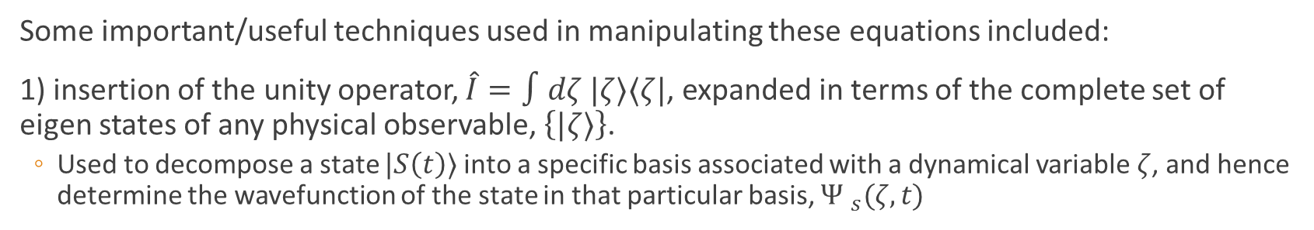
Review of key points from last lecture
Some important/useful techniques used in manipulating these equations included:
1) insertion of the unity operator, $\hat{I}=∫dζ |ζ⟩⟨ζ|$, expanded in terms of the complete set of eigen states of any physical observable, $\left\{|ζ⟩\right\}$.
Used to decompose a state $|S\left(t\right)⟩$ into a specific basis associated with a dynamical variable $ζ$, and hence determine the wavefunction of the state in that particular basis, ${Ψ }_{s}(ζ,t)$
2) recognizing that the wavefunction ${Ψ }_{s}\left(ζ,t\right)=⟨ζ|S\left(t\right)⟩$
3) recognizing that $\left\langle α | β\right\rangle ={\left\langle β | α\right\rangle }^{∗}$

Slide 4
Today:
A few more examples of different wavefunctions; how to find explicit expressions for them, and how the wavefunctions in different bases can be transformed from one to another
A more rigorous treatment of eigen states, and expansions of arbitrary states in eigen state bases, associated with operators that have a continuous eigen spectrum
Motivation for why one might want to “work in a basis other than the position basis”. Note this is equivalent to saying “know the wavefunction of a state in some basis other than the position basis”
Notes:
Go through answers to this question, then get them to work on next question by themselves

Slide 5




I) More manipulation exercise (#1) TPS (2 mins)
Use Dirac notation to express the expansion of an arbitrary state $|S\left(t\right)⟩$ in terms of the eigen states of i) the position operator, $\left\{|x⟩\right\},$ ii), the momentum operator, $\left\{|p⟩\right\}$and iii), the total energy operator, $\left\{|E_{n}⟩\right\}$. Assume that our 1D particle is in a harmonic potential characterized by a natural frequency $ω$.
$$\left|S\left(t\right)\right\rangle =\int{dx ⟨x}\left|S\left(t\right)\right\rangle |x⟩$$
$$\left|S\left(t\right)\right\rangle =\int{dp ⟨p}\left|S\left(t\right)\right\rangle |p⟩$$
$$\left|S\left(t\right)\right\rangle =\sum_{n=0}^{∞}{⟨E_{n}\left|S\left(t\right)\right\rangle \left|E_{n}\right\rangle }$$

Slide 6
I) More manipulation exercise (#1)
For each of the 3 cases, what Dirac equation defines the eigen states and their respective eigen values?
$$\hat{x}\left|x\right\rangle =x\left|x\right\rangle$$
$$\hat{p}\left|p\right\rangle =p\left|p\right\rangle$$
$$\hat{E}|E_{n}⟩=E_{n}|E_{n}⟩$$
Notes:
Immutable statements of the eigen value problem in general terms, but to actually solve the eigen value problem, need to translate these into a specific representation of the states and operators.

Slide 7



I) More manipulation exercise (#2)
Interpret the equations that result from projecting a position basis eigen state, $|x′⟩$, onto the three expansion equations, after you have rendered all bras and kets as explicit functions of the relevant eigen values.
$$⟨x′\left|S\left(t\right)\right\rangle =\int{dx ⟨x}\left|S\left(t\right)\right\rangle ⟨x^{′}|x⟩$$
$$Ψ_{S}(x^{′},t)=\int{dx Ψ_{S}(x,t)}δ(x−x^{′})$$

Slide 8
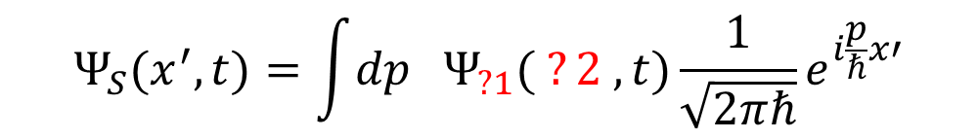

I) More Manipulation exercise (#2)
$$⟨x′\left|S\left(t\right)\right\rangle =\int{dp ⟨p}\left|S\left(t\right)\right\rangle ⟨x^{′}|p⟩$$
$$Ψ_{S}(x^{′},t)=\int{dp Ψ_{?1}( ?2 ,t)}\frac{1}{\sqrt{2πℏ}}e^{i\frac{p}{ℏ}x′}$$

Slide 9
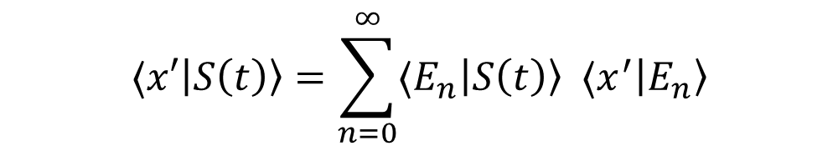
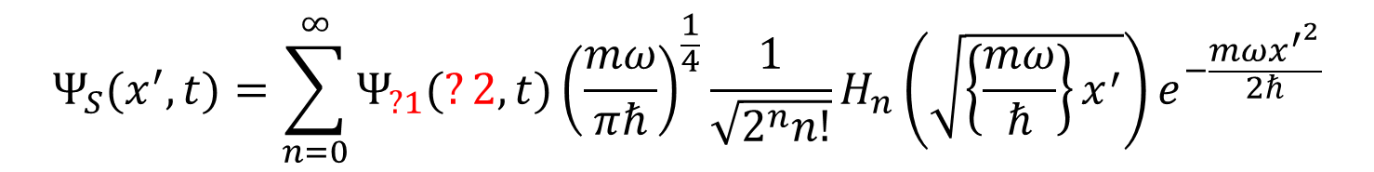
I) More manipulation exercise (#2)
$$⟨x′\left|S\left(t\right)\right\rangle =\sum_{n=0}^{∞}{⟨E_{n}\left|S\left(t\right)\right\rangle ⟨x^{′}\left|E_{n}\right\rangle }$$
$$Ψ_{S}(x^{′},t)=\sum_{n=0}^{∞}{Ψ_{?1}(?2,t){\left(\frac{mω}{πℏ}\right)}^{\frac{1}{4}}\frac{1}{\sqrt{2^{n}n!}}H_{n}\left(\sqrt{\left\{\frac{mω}{ℏ}\right\}x^{′}}\right)e^{−\frac{mω{x^{′}}^{2}}{2ℏ}}}$$

Slide 10


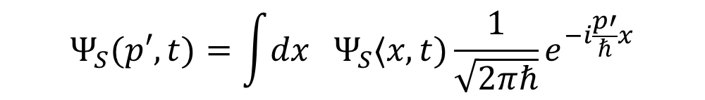
I) More manipulation exercise (#3)
Interpret the equations that result from projecting a momentum basis eigen state, $|p′⟩$, onto the three expansion equations, after you have rendered all bras and kets as explicit functions of the relevant eigen values.
$$⟨p′\left|S\left(t\right)\right\rangle =\int{dx ⟨x}\left|S\left(t\right)\right\rangle ⟨p′|x⟩$$
$$Ψ_{S}(p′,t)=\int{dx Ψ_{S}⟨x,t)}\frac{1}{\sqrt{2πℏ}}e^{−i\frac{p′}{ℏ}x}$$

Slide 11
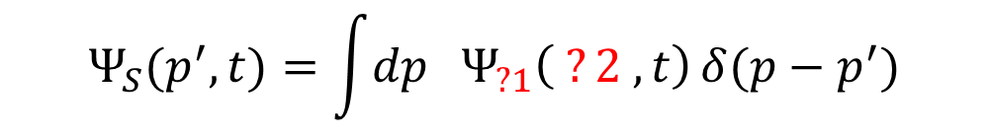

I) More Manipulation exercise (#3)
$$⟨p′\left|S\left(t\right)\right\rangle =\int{dp ⟨p}\left|S\left(t\right)\right\rangle ⟨p^{′}|p⟩$$
$$Ψ_{S}(p^{′},t)=\int{dp Ψ_{?1}\left( ?2 ,t\right)}δ(p−p^{′})$$

Slide 12
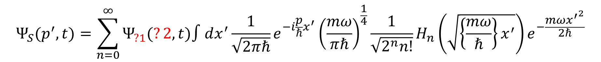


I) More manipulation exercise (#3)
$$⟨p′\left|S\left(t\right)\right\rangle =\sum_{n=0}^{∞}{⟨E_{n}\left|S\left(t\right)\right\rangle ⟨p^{′}|E_{n}⟩}$$
How evaluate ?
$$⟨p^{′}|E_{n}⟩$$
$$Ψ_{S}(p^{′},t)=\sum_{n=0}^{∞}{Ψ_{?1}(?2,t){∫dx^{′}\frac{1}{\sqrt{2πℏ}}e^{−i\frac{p}{ℏ}x^{′}}\left(\frac{mω}{πℏ}\right)}^{\frac{1}{4}}\frac{1}{\sqrt{2^{n}n!}}H_{n}\left(\sqrt{\left\{\frac{mω}{ℏ}\right\}x^{′}}\right)e^{−\frac{mω{x^{′}}^{2}}{2ℏ}}}$$
What do all of these equations represent?
Bases transformations of wavefunction representations of the state $|S\left(t\right)⟩$.
Notes:
Do <p’|E_n> on board

Slide 13
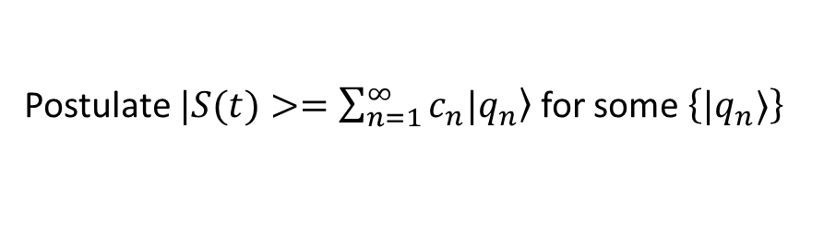
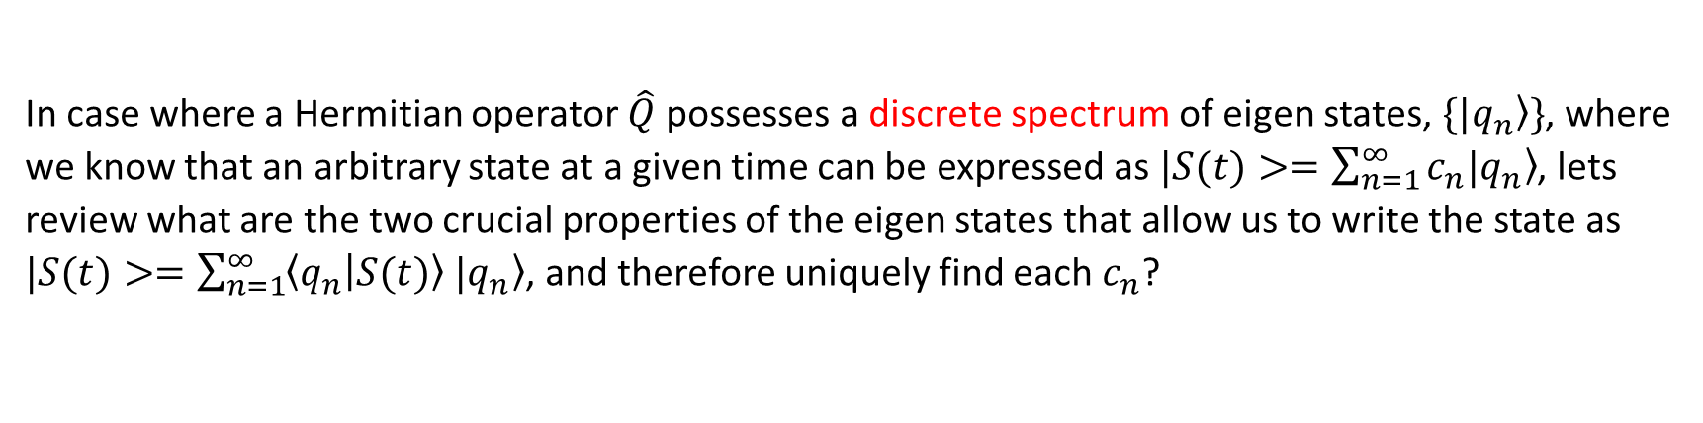
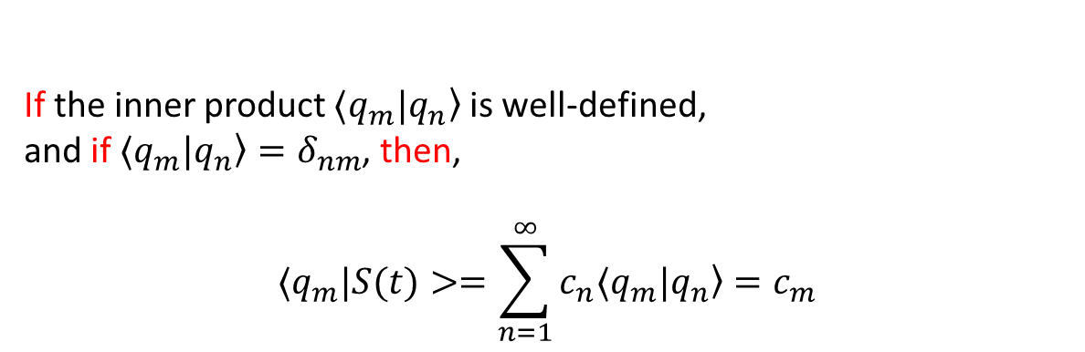
II) Rigorous treatment of operators with continuous eigen spectra
In case where a Hermitian operator $\hat{Q}$ possesses a discrete spectrum of eigen states, $\{|\left.q_{n}\right\rangle \}$, where we know that an arbitrary state at a given time can be expressed as $|S(t)>=\sum_{n=1}^{∞}{c_{n}|\left.q_{n}\right\rangle }$, lets review what are the two crucial properties of the eigen states that allow us to write the state as $|S(t)>=\sum_{n=1}^{∞}{\left\langle q_{n} | S(t)\right\rangle |\left.q_{n}\right\rangle }$, and therefore uniquely find each $c_{n}$?
Postulate $|S(t)>=\sum_{n=1}^{∞}{c_{n}|\left.q_{n}\right\rangle }$ for some $\left\{|q_{n}⟩\right\}$
If the inner product $⟨q_{m}|\left.q_{n}\right\rangle$ is well-defined,
and if $⟨q_{m}|\left.q_{n}\right\rangle =δ_{nm}$, then,
$$⟨q_{m}|S(t)>=\sum_{n=1}^{∞}{c_{n}⟨q_{m}|\left.q_{n}\right\rangle }=c_{m}$$

Slide 14
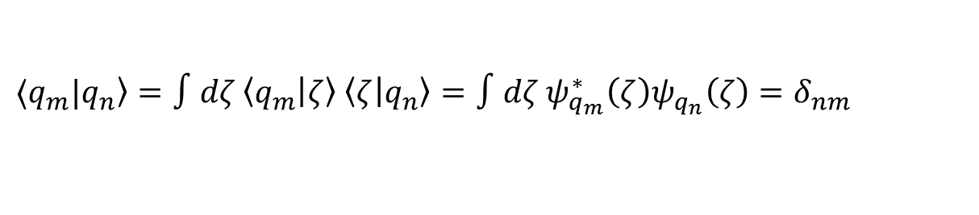

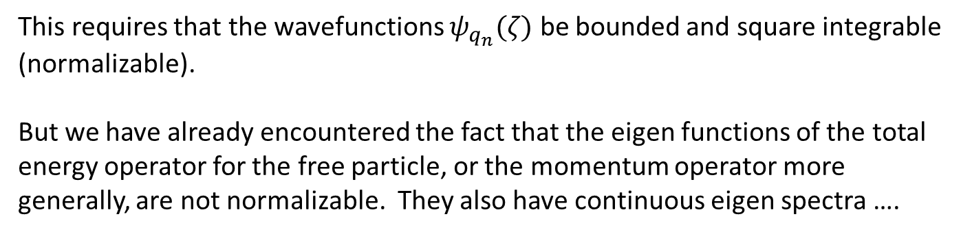
II) Rigorous treatment of operators with continuous eigen spectra
What do these properties imply about the wavefunctions in any given basis that might be used to actually evaluate the inner product $⟨q_{m}|\left.q_{n}\right\rangle$?
$⟨q_{m}|\left.q_{n}\right\rangle =∫dζ \left\langle q_{m} | ζ\right\rangle \left\langle ζ | q_{n}\right\rangle =∫dζ ψ_{q_{m}}^{∗}\left(ζ\right)ψ_{q_{n}}\left(ζ\right)=δ_{nm}$
This requires that the wavefunctions $ψ_{q_{n}}(ζ)$ be bounded and square integrable (normalizable).
But we have already encountered the fact that the eigen functions of the total energy operator for the free particle, or the momentum operator more generally, are not normalizable. They also have continuous eigen spectra ….

Slide 15
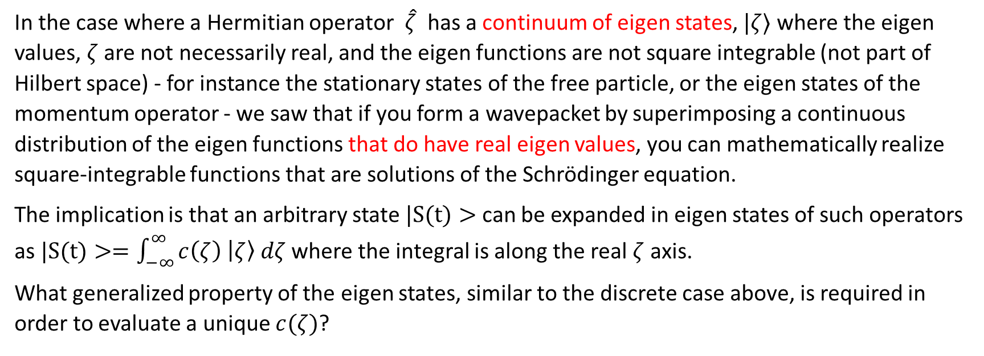
II) Rigorous treatment of operators with continuous eigen spectra
In the case where a Hermitian operator $\hat{ζ}$ has a continuum of eigen states, $|ζ⟩$where the eigen values, $ζ$ are not necessarily real, and the eigen functions are not square integrable (not part of Hilbert space) - for instance the stationary states of the free particle, or the eigen states of the momentum operator - we saw that if you form a wavepacket by superimposing a continuous distribution of the eigen functions that do have real eigen values, you can mathematically realize square-integrable functions that are solutions of the Schrödinger equation.
The implication is that an arbitrary state $|S(t)>$ can be expanded in eigen states of such operators as $|S(t)>=\int_{−∞}^{∞}{c\left(ζ\right) \left|ζ\right\rangle dζ}$ where the integral is along the real $ζ$ axis.
What generalized property of the eigen states, similar to the discrete case above, is required in order to evaluate a unique $c(ζ)$?

Slide 16
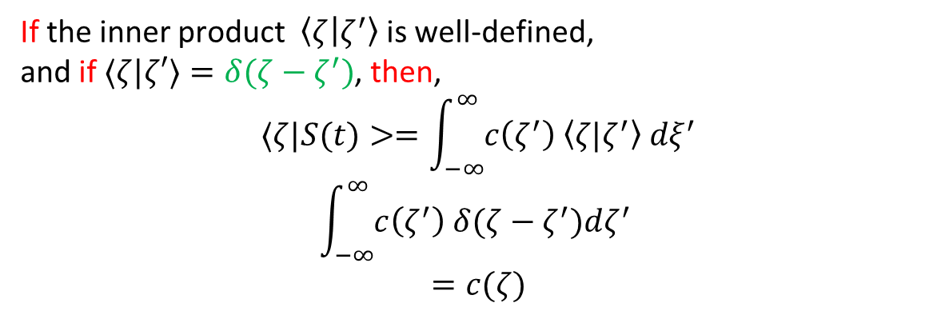
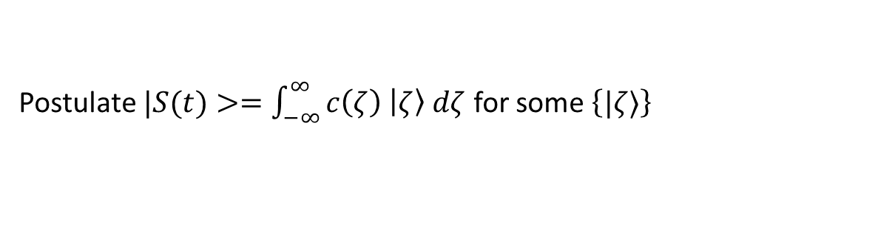
II) Rigorous treatment of operators with continuous eigen spectra
Postulate $|S(t)>=\int_{−∞}^{∞}{c\left(ζ\right) \left|ζ\right\rangle dζ}$ for some $\left\{|ζ⟩\right\}$
If the inner product $\left\langle ζ | ζ^{′}\right\rangle$ is well-defined,
and if $⟨ζ|ζ′⟩=δ(ζ−ζ^{′})$, then,
$$⟨ζ|S(t)>=\int_{−∞}^{∞}{c\left(ζ^{′}\right) \left\langle ζ{|ζ}^{′}\right\rangle dξ^{′}}$$
$$\int_{−∞}^{∞}{c\left(ζ^{′}\right) δ(ζ−ζ^{′})dζ^{′}}$$
$$=c(ζ)$$

Slide 17
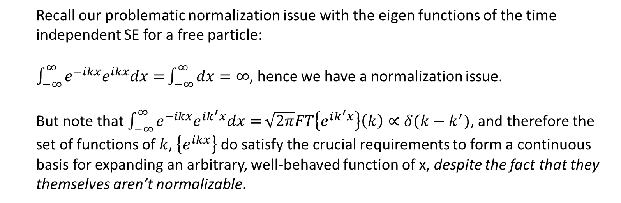
II) Rigorous treatment of operators with continuous eigen spectra
Can finally resolve, or put to rest our fudging around the non-normalizability issue with the free particle eigen states, and having to invoke an artificial discretization of space to gain a conceptual understanding of the position operator’s eigen functions.
Recall our problematic normalization issue with the eigen functions of the time independent SE for a free particle:
$\int_{−∞}^{∞}{e^{−ikx}e^{ikx}dx=}\int_{−∞}^{∞}{dx}=∞$, hence we have a normalization issue.
But note that $\int_{−∞}^{∞}{e^{−ikx}e^{ik^{′}x}dx=}\sqrt{2π}FT\left\{e^{ik^{′}x}\right\}\left(k\right)∝δ(k−k^{′})$, and therefore the set of functions of $k$, $\left\{e^{ikx}\right\}$ do satisfy the crucial requirements to form a continuous basis for expanding an arbitrary, well-behaved function of x, despite the fact that they themselves aren’t normalizable.
Notes:
Will deal with the normalization in tutorial tomorrow.

Slide 18
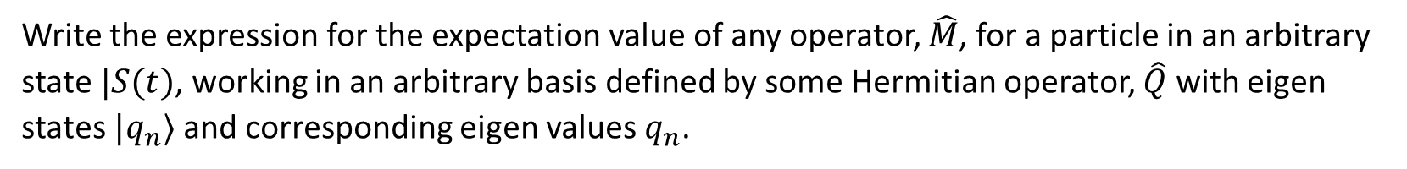
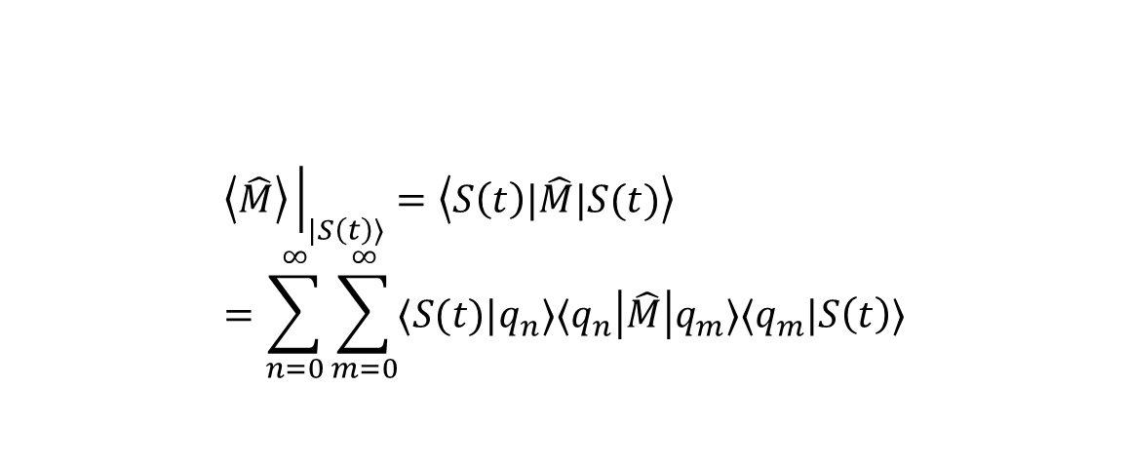
III) Relevance of wavefunctions in different bases
Write the expression for the expectation value of any operator, $\hat{M}$, for a particle in an arbitrary state $|S(t)$, working in an arbitrary basis defined by some Hermitian operator, $\hat{Q}$ with eigen states $|q_{n}⟩$ and corresponding eigen values $q_{n}$.
$$\left\langle \hat{M}\right\rangle {\left.​\right|}_{|S\left(t\right)⟩}=\left\langle S\left(t\right)|\hat{M}|S(t)\right\rangle =\sum_{n=0}^{∞}{\sum_{m=0}^{∞}{⟨S(t)|q_{n}⟩⟨q_{n}\left|\hat{M}\right|q_{m}⟩⟨q_{m}|S\left(t\right)⟩}}$$
Notes:
Do on board

Slide 19
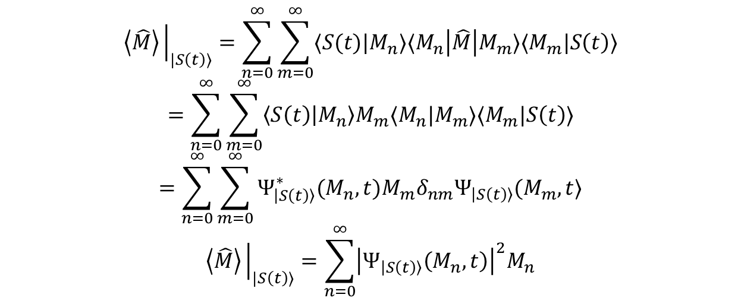
III) Relevance of wavefunctions in different bases
What if $\hat{Q}=\hat{M}$?
$$\left\langle \hat{M}\right\rangle {\left.​\right|}_{|S\left(t\right)⟩}=\sum_{n=0}^{∞}{\sum_{m=0}^{∞}{⟨S(t)|M_{n}⟩⟨M_{n}\left|\hat{M}\right|M_{m}⟩⟨M_{m}|S\left(t\right)⟩}}$$
$$=\sum_{n=0}^{∞}{\sum_{m=0}^{∞}{\left\langle S\left(t\right) | M_{n}\right\rangle M_{m}⟨M_{n}|M_{m}⟩⟨M_{m}|S\left(t\right)⟩}}$$
$$=\sum_{n=0}^{∞}{\sum_{m=0}^{∞}{Ψ_{\left|S\left(t\right)\right\rangle }^{∗}(M_{n},t)M_{m}δ_{nm}Ψ_{\left|S\left(t\right)\right\rangle }(M_{m},t⟩}}$$
$$\left\langle \hat{M}\right\rangle {\left.​\right|}_{|S\left(t\right)⟩}=\sum_{n=0}^{∞}{{\left|Ψ_{\left|S\left(t\right)\right\rangle }\left(M_{n},t\right)\right|}^{2}M_{n}}$$
Notes:
What name would you logically associate with the quantity |<q_n|S(t)>|^2 considered as a function of q_n?
Ans: the state’s probability distribution in q_n space.

Slide 20
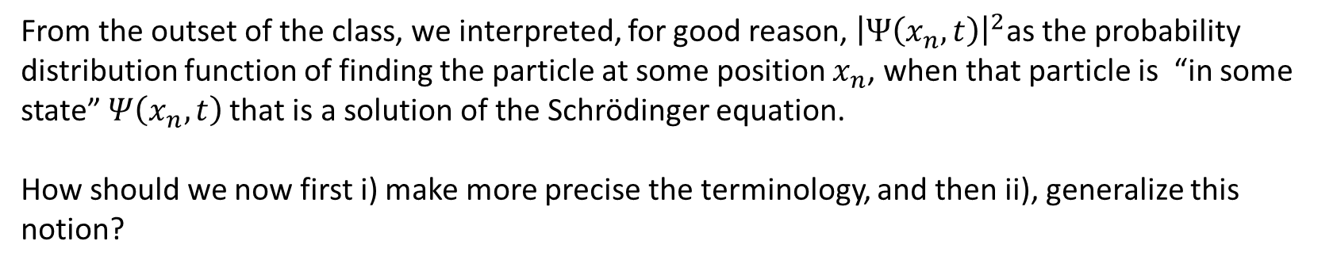


III) Relevance of wavefunctions in different bases
What if $\hat{Q}=\hat{M}=\hat{x}$?
$$\left\langle \hat{M}\right\rangle {\left.​\right|}_{|S\left(t\right)⟩}=\sum_{n=0}^{∞}{{\left|Ψ_{\left|S\left(t\right)\right\rangle }\left(M_{n},t\right)\right|}^{2}M_{n}}$$
becomes
$$\left\langle \hat{x}\right\rangle {\left.​\right|}_{|S\left(t\right)⟩}=\sum_{n=0}^{∞}{{\left|Ψ_{\left|S\left(t\right)\right\rangle }\left(x_{n},t\right)\right|}^{2}x_{n}}$$
From the outset of the class, we interpreted, for good reason, ${\left|Ψ\left(x_{n},t\right)\right|}^{2}$as the probability distribution function of finding the particle at some position $x_{n}$, when that particle is “in some state” $Ψ\left(x_{n},t\right)$that is a solution of the Schrödinger equation.
How should we now first i) make more precise the terminology, and then ii), generalize this notion?
Notes:
What name would you logically associate with the quantity |<q_n|S(t)>|^2 considered as a function of q_n?
Ans: the state’s probability distribution in q_n space.

Slide 21

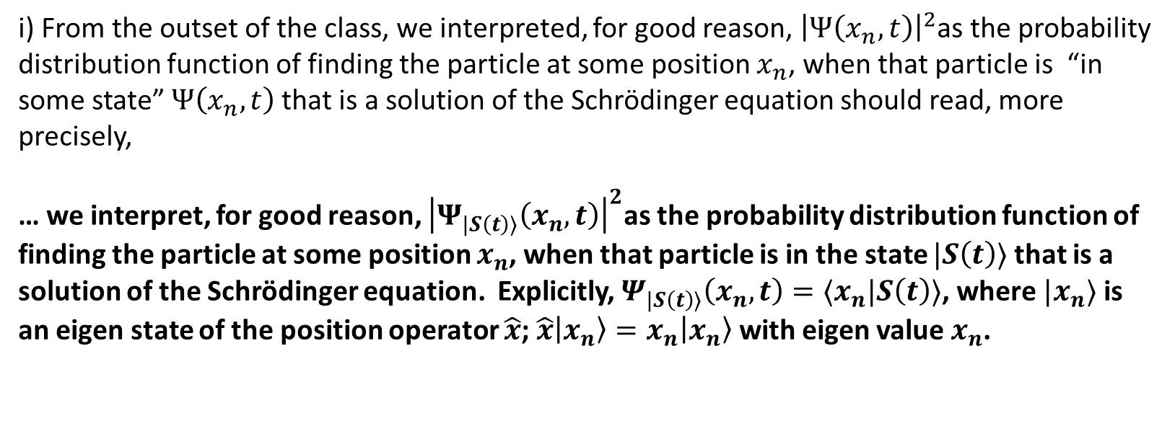
III) Relevance of wavefunctions in different bases
i) From the outset of the class, we interpreted, for good reason, ${\left|Ψ\left(x_{n},t\right)\right|}^{2}$as the probability distribution function of finding the particle at some position $x_{n}$, when that particle is “in some state” $Ψ\left(x_{n},t\right)$that is a solution of the Schrödinger equation should read, more precisely,
… we interpret, for good reason, ${\left|Ψ_{|S\left(t\right)⟩}\left(x_{n},t\right)\right|}^{2}$as the probability distribution function of finding the particle at some position $x_{n}$, when that particle is in the state $|S\left(t\right)⟩$that is a solution of the Schrödinger equation. Explicitly, $Ψ_{|S\left(t\right)⟩}\left(x_{n},t\right)=⟨x_{n}|S\left(t\right)⟩$, where $|x_{n}⟩$ is an eigen state of the position operator $\hat{x}$; $\hat{x}\left|x_{n}\right\rangle =x_{n}\left|x_{n}\right\rangle$ with eigen value $x_{n}$.
$$\left\langle \hat{x}\right\rangle {\left.​\right|}_{|S\left(t\right)⟩}=\sum_{n=0}^{∞}{{\left|Ψ_{\left|S\left(t\right)\right\rangle }\left(x_{n},t\right)\right|}^{2}x_{n}}$$
Notes:
What name would you logically associate with the quantity |<q_n|S(t)>|^2 considered as a function of q_n?
Ans: the state’s probability distribution in q_n space.

Slide 22
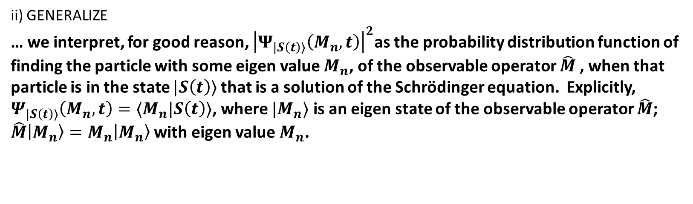

III) Relevance of wavefunctions in different bases
$$\left\langle \hat{M}\right\rangle {\left.​\right|}_{|S\left(t\right)⟩}=\sum_{n=0}^{∞}{{\left|Ψ_{\left|S\left(t\right)\right\rangle }\left(M_{n},t\right)\right|}^{2}M_{n}}$$
ii) GENERALIZE
… we interpret, for good reason, ${\left|Ψ_{|S\left(t\right)⟩}\left(M_{n},t\right)\right|}^{2}$as the probability distribution function of finding the particle with some eigen value $M_{n}$, of the observable operator $\hat{M}$, when that particle is in the state $|S\left(t\right)⟩$that is a solution of the Schrödinger equation. Explicitly, $Ψ_{|S\left(t\right)⟩}\left(M_{n},t\right)=⟨M_{n}|S\left(t\right)⟩$, where $|M_{n}⟩$ is an eigen state of the observable operator $\hat{M}$; $\hat{M}\left|M_{n}\right\rangle =M_{n}\left|M_{n}\right\rangle$ with eigen value $M_{n}$.
Notes:
What name would you logically associate with the quantity |<q_n|S(t)>|^2 considered as a function of q_n?
Ans: the state’s probability distribution in q_n space.

